Slide 1

The Sectional Crisis
Chapter 13

Slide 2
Free Soil, Free Labor, Free Men
Free Soil Party
  Bridged eastern and western leadership
  Called for an end to slavery in Washington, DC
  Called for a halt on slavery’s expansion in the territories
May 1848: Wisconsin admitted as a free state
July 1848: Women’s Rights Movement met at Seneca Falls, NY
November 1848: Spirit of reform failed to yield results at the polls
1848 Reforms came to an end

Slide 3
Free Soil, Free Labor, Free Men
In 1850, California asked to be admitted to the Union as a free state
Senators Henry Clay and Stephen Douglas offered a plan that came to be known as the Compromise of 1850
  1) California would enter the Union as a free state
  2) Slave trade would be abolished in D.C.
  3) A new law would allow southerners to reclaim runaway slaves
  4) The status of slavery in the remaining territories acquired from Mexico would be left to the decision of the local white inhabitants
Antislavery critics believed slaveholders co-opted the federal government
Antislavery leaders argued that Washington worked on behalf of slaveholders; ignored white working men

Slide 4
Free Soil, Free Labor, Free Men
The Fugitive Slave Act allowed federal commissioners to determine the fate of alleged fugitives
  No jury trial
  No testimony by the accused individual
  Prohibited local authorities from interfering with the capture of fugitives
  Required individual citizens to assist in such capture when called upon by federal agents
The law further widened sectional divisions
Reinvigorated the Underground Railroad
Black northerners responded by heading farther north to Canada

Slide 5
Free Soil, Free Labor, Free Men
1854: Illinois Senator Stephen A. Douglas introduced a bill to provide territorial governments for Kansas & Nebraska, located within the Louisiana purchase
Douglas hoped to satisfy southern congressmen by applying the principle of popular sovereignty
Popular sovereignty – the status of slavery would be determined by the votes of local settlers, not Congress

Slide 6
Free Soil, Free Labor, Free Men
The Kansas-Nebraska Act
  Established popular sovereignty in Kansas and Nebraska territories (repealed the Missouri Compromise)
  Whig Party divided over the Act and collapsed
  The South became solidly democratic
  Most northern Whigs joined a new organization, the Republican Party, dedicated to preventing the further expansion of slavery
Americans in the North resisted what they believed to be a pro-slavery government (e.g., fugitive slaves Anthony Burns and Joshua Glover, and hundreds of others)

Slide 7
Free Soil, Free Labor, Free Men
The Free Labor Ideology
  The Republican Party’s appeal rested on the idea of “free labor”
  Republicans were not abolitionists but focused on the spread of slavery

Slide 8
From Sectional Crisis to National Crisis
When Kansas held elections in 1854 & 1855, hundreds of proslavery Missourians crossed the border to cast fraudulent ballots
President Pierce recognized the legitimacy of the proslavery legislature
Settlers from free states established a rival government
Civil war broke out in Kansas known as “Bleeding Kansas”

Slide 9
From Sectional Crisis to National Crisis
The Dred Scott Decision
  During the 1830s, Scott accompanied his owner, Dr. John Emerson of Missouri, from Missouri (slave territory) to Illinois & Wisconsin (nonslave territories)
  After return to Missouri, Scott sued for his freedom, claiming that residence on free soil made him free
  March 1857: U.S. Supreme Court ruling in Scott v. Sanford
    Only white persons could be citizens of the U.S.
    Congress possessed no power to bar slavery from a territory

Slide 10
From Sectional Crisis to National Crisis
1860: Abraham Lincoln won the presidential election
  40% of the popular vote
  Not a single southern vote in the Electoral College
Following Lincoln’s election, 7 states stretching from South Carolina to Texas seceded from the Union
  December 20: South Carolina seceded first (highest percentage of slaves)
  Declaration of the Immediate Causes of Secession
  Highlighted failure of the federal government to enforce the Fugitive Slave Act

Slide 11
From Sectional Crisis to National Crisis
February, 1861: Seceding states formed the Confederate States of America
  Adopted a constitution
  Named Jefferson Davis of Mississippi as their president
March 4, 1861: Lincoln’s Inaugural Address
April 12, 1861: the Confederacy fired on Fort Sumter, SC
April 15, 1861: Lincoln called for 75,000 troops to crush the rebellion
Civil War had begun

Slide 12
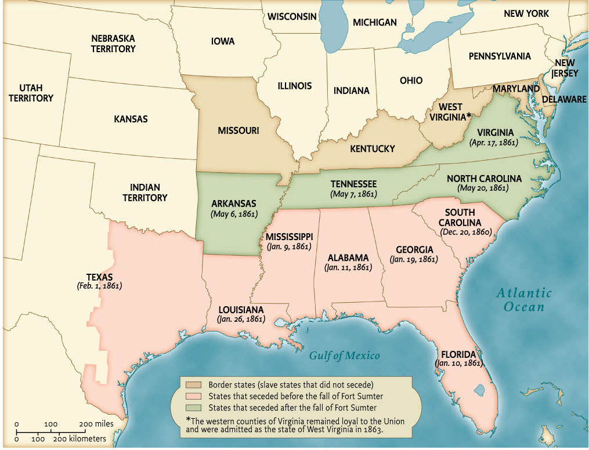
Map 14.1 The Secession of Southern States, 1860-1861
Give Me Liberty!: An American history, 3rd Edition
Copyright © 2011 W.W. Norton & Company

